Slide 1


Regularizing Neural Machine Translation by Target-bidirectional Agreement
Zhirui Zhang¹, Shuangzhi Wu², Shujie Liu³, Mu Li³, Ming Zhou³, Tong Xu¹
¹University of Science and Technology of China
²Harbin Institute of Technology ³Microsoft Research Asia
¹zrustc11@gmail.com tongxu@ustc.edu.cn
²³{v-shuawu, shujliu, muli, mingzhou}@microsoft.com

Slide 2
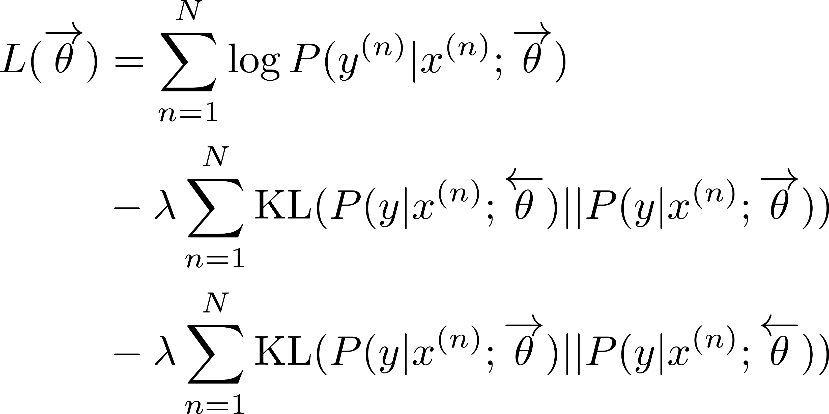
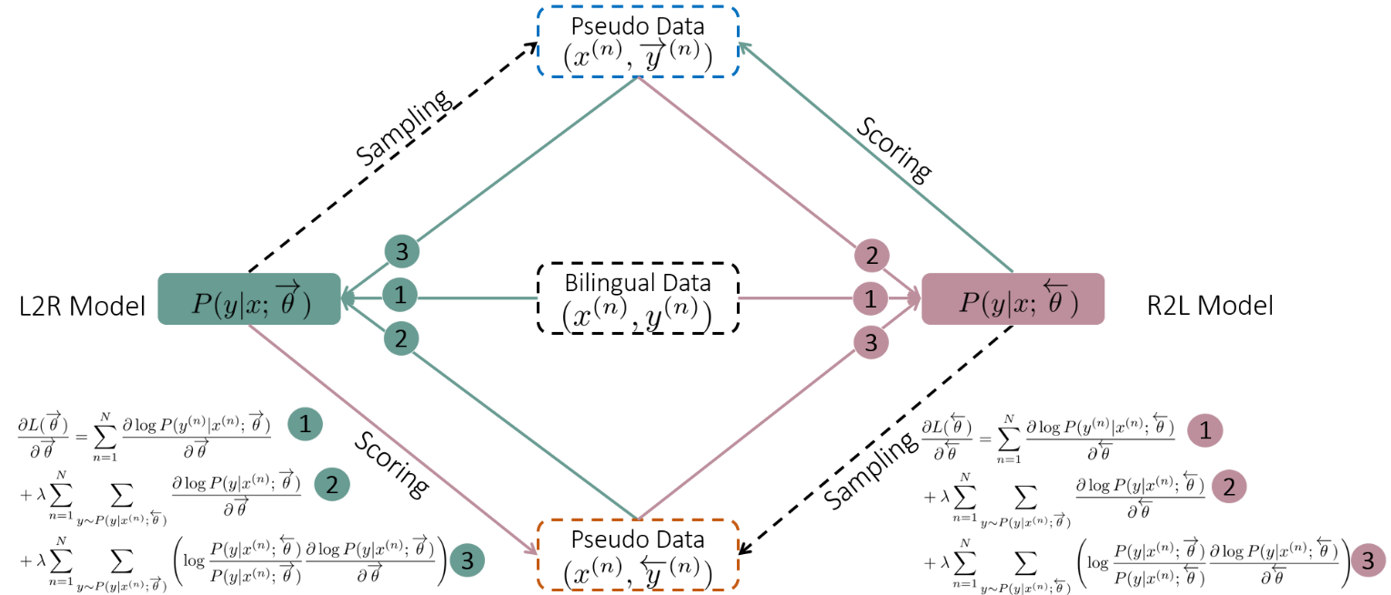
Target-bidirectional Agreement Regularization
Introduce two Kullback-Leibler (KL) divergence regularization terms
Joint Training Framework
Weight

